Slide 1
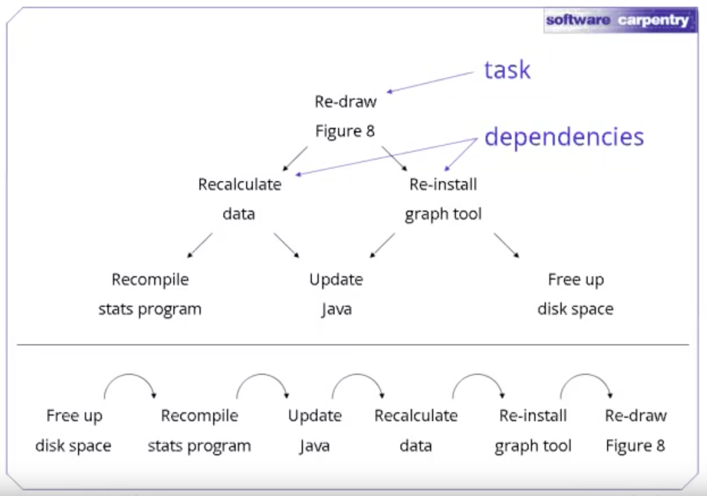
Why use GNU make?
https://www.youtube.com/watch?v=djPWVqn7vjY&html5=True

Slide 2
Illumina – library prep
DNA
Subfragments
1
2
3

Slide 3
Illumina – cycle 1
DNA
Subfragments
1
2
3
Fastq file
@1
A
+1
4
@2
C
+2
8
@3
T
+3
1
A
C
T
https://en.wikipedia.org/wiki/FASTQ_format

Slide 4
Illumina – cycle 2
DNA
Subfragments
1
2
3
Fastq file
@1
AG
+1
4.
@2
CC
+2
8F
@3
TA
+3
1C
G
C
A
https://en.wikipedia.org/wiki/FASTQ_format

Slide 5
Illumina – cycle 3
DNA
Subfragments
1
2
3
Fastq file
@1
AGT
+1
4.%
@2
CCC
+2
8Fa
@3
TAT
+3
1C?
T
C
T
https://en.wikipedia.org/wiki/FASTQ_format

Slide 6
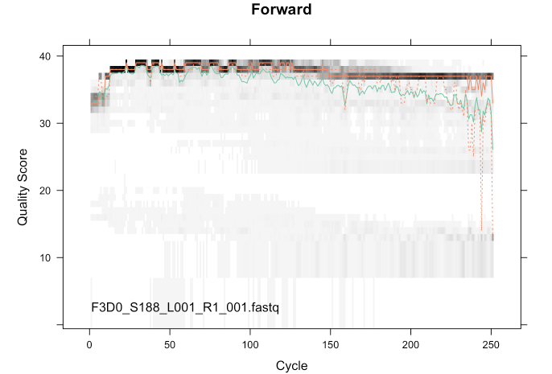
Why its useful to check quality

Slide 7
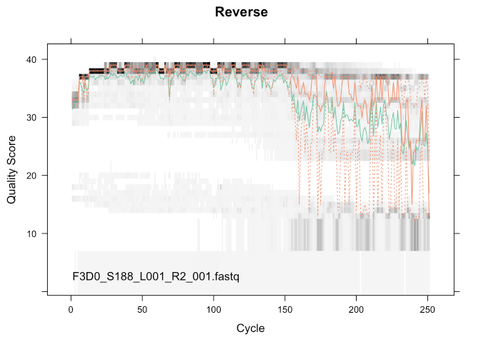

Slide 8
Sequence Alignment
Tim Read
IBS574

Slide 9
DNA Alignment is fundamental to bioinformatics

Slide 10
Pairwise Alignment
BLAST
Reference Mapping
Whole Genome Alignment (WGA)
De novo assembly

Slide 11
However, only a few people that use alignment algorithms actually understand how they work

Slide 12
Learning Objectives
Gain an intuition about how DNA alignment works

Slide 13
Learning Objectives
Gain an intuition about how DNA alignment works
Think about how much we need to know about algorithms when we run them
Can we treat them as “Black Boxes”?
What are the dangers of using algorithms that we don’t understand?

Slide 14
Pairwise Sequence Alignment
AATGTGCCTTGTTATA
||| ||| |||||
AAT---CCTAGTTAT-
A deceptively simple problem
How to score an alignment?
How to find the best alignment?

Slide 15
Hamming distance
Simple metric to compare sequences (DNA, amino acids, text, binary etc)
How many substitutions between strings?

Slide 16
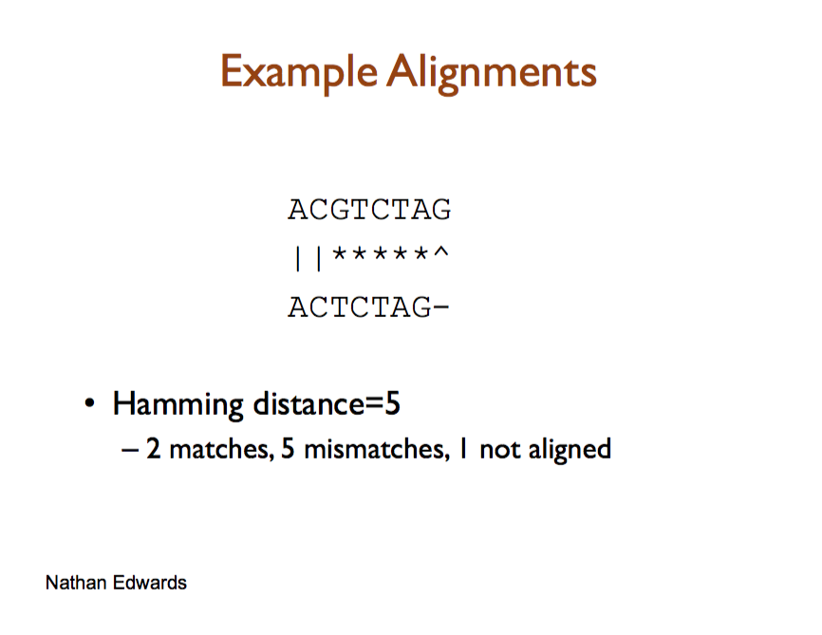

Slide 17
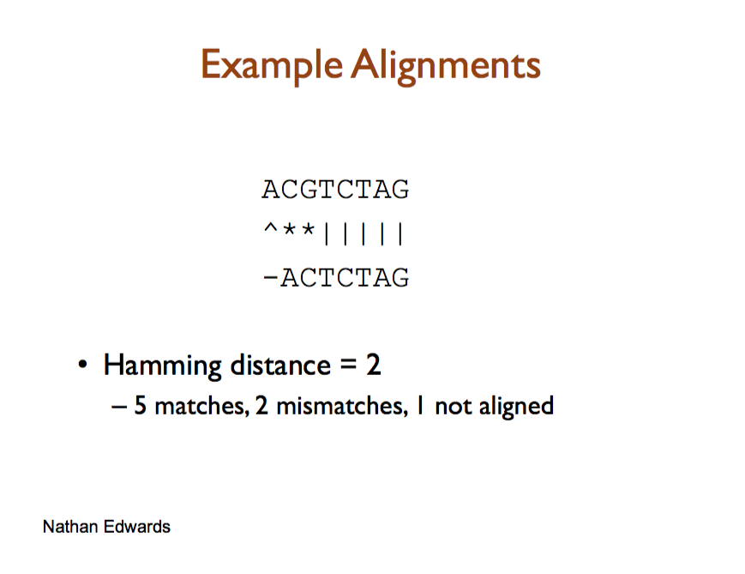

Slide 18
What is the Hamming distance?
AATGTGCCTTGTTATA
||| ||| |||||
AAT---CCTAGTTAT-

Slide 19
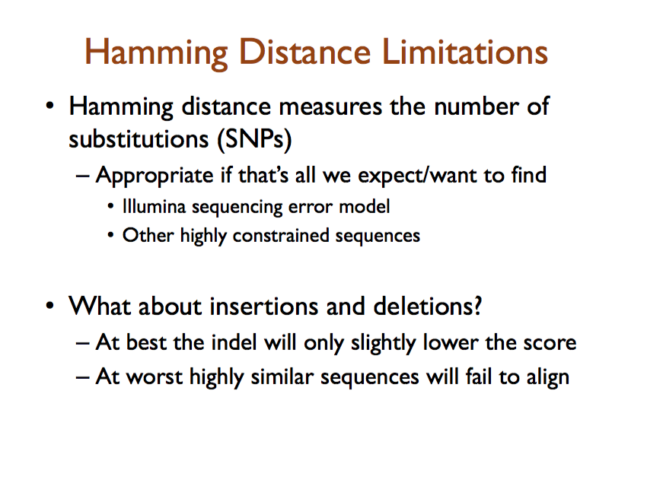
M. Schatz

Slide 20
The alignment problem
How to find the arrangement of sequences that give the minimum distance?
Even for relatively short sequences, there are lots of possible alignments
Notes:
(Think about the assumptions behind looking for the minimum distance a little)

Slide 21
Number possible alignments of 2 sequences of length n is ( )
If n = 5, there are 252 combinations
If n = 50, there are > 10²⁸ combinations
2n
n
2n
( ) means number of n-element subsets of a k-element set
= (2n)!/(n!)²
n

Slide 22
The Needleman-Wunsch Global Alignment algorithm
The problem of finding the best possible alignment for 2 sequences was first solved by the Needleman-Wunsch algorithm (1970)
The N-W algorithm is proven to find the best alignment of 2 sequences
By the ‘best’ alignment, we mean the alignment that implies the fewest number of substitutions(mutations) in the 2 sequences
Avril Cauglin Sanger Institute

Slide 23
The Needleman-Wunsch algorithm
The Needleman-Wunsch algorithm saves the trouble of assessing all the many possible alignments to find the best one
The N-W algorithm takes time proportion to n² to find the best alignment of two sequences that are both n letters long
Avril Cauglin
Notes:
How many times faster is it to find the best alignment for sequences “RQQEP” & “QQESP” using the Needleman-Wunsch algorithm, compared to assessing each possible alignment one-by-one?
The sequence length, n, is 5 here. This means it will take time proportional to n²=25 to find the best alignment using N-W It will take time proportional to ( ) = 252 to find the best alignment by assessing each possible alignment one-by-one. This means that we can find the best alignment about 10 times (=252/25) faster by using N-W.

Slide 24
The Needleman-Wunsch algorithm uses an approach called dynamic programming (d.p.)
d.p. algorithms solve problems by breaking a large problem into smaller easy problems of a similar type
If S1 is m letters long, & S2 is n letters long, we need to do this for all m×n possible subsequences of S1 and S2
So N-W takes time proportional to m×n to run
Avril Cauglin

Slide 25
Technical stuff
n² is much smaller than ( ), so N-W is much faster than assessing all possible alignments one-by-one
eg. for n=11, n²=121, ( )=705432, so N-W is ~5830-fold faster (705432/121) than assessing all alignments
2n
n
2n
n

Slide 26
To use N-W, we must first define:
A scoring function (σ): defines the score to give to a substitution mutation eg. -1 for a match, -1 for mismatch
A gap penalty: defines the score to give to an insertion or deletion mutation, eg. -1
A recurrence relation: defines what actions we repeat at each iteration (step) of the algorithm:
Avril Cauglin

Slide 27
There are 2 parts to computing the best alignment using the N-W algorithm:
Fill up a matrix (table) T using the recurrence relation
The traceback step : use the filled-in matrix T to work out the best alignment

Slide 28
Scoring functions
We define a scoring function σ(S₁(i), S₂(j)) for pairs of nucleotides (S₁(i), S₂(j))
σ(S1(i), S2(j)) is the cost (score) of aligning symbols S1(i) & S2(j)
ie. σ(S1(i), S2(j)) is the cost (score) for a substitution mutation from S1(i) → S2(j)
A simple scoring function σ is a score of +1 for matches, and -1 for mismatches
A convenient way of representing many scoring functions is a substitution matrix
Avril Cauglin
Notes:
This can be written as: (the symbol means ‘for all’)
σ(a,b) = +1 and σ(a,b) = -1

Slide 29
Letter b
 | A | R | N | D | C | Q | E | G | H | I | L | K | M | F | P | S | T | W | Y | V
A | 1 | -1 | -1 | -1 | -1 | -1 | -1 | -1 | -1 | -1 | -1 | -1 | -1 | -1 | -1 | -1 | -1 | -1 | -1 | -1
R | -1 | 1 | -1 | -1 | -1 | -1 | -1 | -1 | -1 | -1 | -1 | -1 | -1 | -1 | -1 | -1 | -1 | -1 | -1 | -1
N | -1 | -1 | 1 | -1 | -1 | -1 | -1 | -1 | -1 | -1 | -1 | -1 | -1 | -1 | -1 | -1 | -1 | -1 | -1 | -1
D | -1 | -1 | -1 | 1 | -1 | -1 | -1 | -1 | -1 | -1 | -1 | -1 | -1 | -1 | -1 | -1 | -1 | -1 | -1 | -1
C | -1 | -1 | -1 | -1 | 1 | -1 | -1 | -1 | -1 | -1 | -1 | -1 | -1 | -1 | -1 | -1 | -1 | -1 | -1 | -1
Q | -1 | -1 | -1 | -1 | -1 | 1 | -1 | -1 | -1 | -1 | -1 | -1 | -1 | -1 | -1 | -1 | -1 | -1 | -1 | -1
E | -1 | -1 | -1 | -1 | -1 | -1 | 1 | -1 | -1 | -1 | -1 | -1 | -1 | -1 | -1 | -1 | -1 | -1 | -1 | -1
G | -1 | -1 | -1 | -1 | -1 | -1 | -1 | 1 | -1 | -1 | -1 | -1 | -1 | -1 | -1 | -1 | -1 | -1 | -1 | -1
H | -1 | -1 | -1 | -1 | -1 | -1 | -1 | -1 | 1 | -1 | -1 | -1 | -1 | -1 | -1 | -1 | -1 | -1 | -1 | -1
I | -1 | -1 | -1 | -1 | -1 | -1 | -1 | -1 | -1 | 1 | -1 | -1 | -1 | -1 | -1 | -1 | -1 | -1 | -1 | -1
L | -1 | -1 | -1 | -1 | -1 | -1 | -1 | -1 | -1 | -1 | 1 | -1 | -1 | -1 | -1 | -1 | -1 | -1 | -1 | -1
K | -1 | -1 | -1 | -1 | -1 | -1 | -1 | -1 | -1 | -1 | -1 | 1 | -1 | -1 | -1 | -1 | -1 | -1 | -1 | -1
M | -1 | -1 | -1 | -1 | -1 | -1 | -1 | -1 | -1 | -1 | -1 | -1 | 1 | -1 | -1 | -1 | -1 | -1 | -1 | -1
F | -1 | -1 | -1 | -1 | -1 | -1 | -1 | -1 | -1 | -1 | -1 | -1 | -1 | 1 | -1 | -1 | -1 | -1 | -1 | -1
P | -1 | -1 | -1 | -1 | -1 | -1 | -1 | -1 | -1 | -1 | -1 | -1 | -1 | -1 | 1 | -1 | -1 | -1 | -1 | -1
S | -1 | -1 | -1 | -1 | -1 | -1 | -1 | -1 | -1 | -1 | -1 | -1 | -1 | -1 | -1 | 1 | -1 | -1 | -1 | -1
T | -1 | -1 | -1 | -1 | -1 | -1 | -1 | -1 | -1 | -1 | -1 | -1 | -1 | -1 | -1 | -1 | 1 | -1 | -1 | -1
W | -1 | -1 | -1 | -1 | -1 | -1 | -1 | -1 | -1 | -1 | -1 | -1 | -1 | -1 | -1 | -1 | -1 | 1 | -1 | -1
Y | -1 | -1 | -1 | -1 | -1 | -1 | -1 | -1 | -1 | -1 | -1 | -1 | -1 | -1 | -1 | -1 | -1 | -1 | 1 | -1
V | -1 | -1 | -1 | -1 | -1 | -1 | -1 | -1 | -1 | -1 | -1 | -1 | -1 | -1 | -1 | -1 | -1 | -1 | -1 | 1
Letter b
 | A | C | G | T
A | +1 | -1 | -1 | -1
C | -1 | +1 | -1 | -1
G | -1 | -1 | +1 | -1
T | -1 | -1 | -1 | +1
Letter a
Letter a
Avril Cauglin

Slide 30
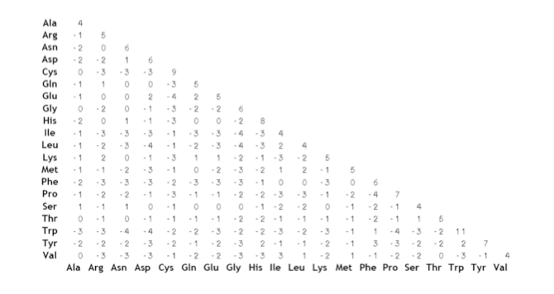
Another example – Blosum62
These example matrices are for amino acids but there are also simpler matrices for nucleotides

Slide 31
N-W: Initialising table T
To align 2 sequences S₁ & S₂ of lengths m & n, N-W starts by building a table T with m+1 columns & n+1 rows:
eg. for S₁=‘TGGTG’ & S₂=‘ATCGT’, m=5 and n=5:
We number the columns i=0,1,2,....m
We number the rows j=0,1,2,...n
 |  | T | G | G | T | G
A
T
C
G
T
Table T
i=0
i=1
i=2
i=3
i=4
i=5
 |  | T | G | G | T | G
A
T
C
G
T
j=0
j=1
j=2
j=3
j=4
j=5
Avril Cauglin

Slide 32
T(i, j) is the cell at the intersection of column i and row j
eg. for S₁=‘TGGTG’ & S₂=‘ATCGT’, m=5 and n=5:
The N-W algorithm starts by initialising (setting the initial value of) T(0,0) to zero:
i=0
i=1
i=2
i=3
i=4
i=5
 |  | T | G | G | T | G
A
T
C
G
T
j=0
j=1
Table T
T(3,2)
j=2
j=3
j=4
j=5
 |  | T | G | G | T | G
 | 0
A
T
C
G
T
Avril Cauglin

Slide 33
The table T is then filled in using the recurrence relation:
T(i-1, j-1) + σ(S₁(i), S₂(j)) # ie the score from the substitution matrix
T(i-1, j) + gap penalty
T(i, j-1) + gap penalty
This means that the value in cell T(i, j) is set to be the maximum of the three possibilities
T(i-1, j-1) is the value in the previous column & previous row
T(i-1, j) is the value in the previous column & same row
T(i, j-1) is the value in the same column & previous row
i=0
i=1
i=2
i=3
i=4
i=5
 |  | T | G | G | T | G
A
T
C
G
T
 |  | T | G | G | T | G
A
T
C
G
T
 |  | T | G | G | T | G
A
T
C
G
T
 |  | T | G | G | T | G
A
T
C
G
T
j=0
T(i, j-1) = T(3,1)
j=1
T(i-1, j-1) = T(2,1)
Table T
T(i, j) = T(3,2)
j=2
j=3
T(i-1, j) = T(2,2)
j=4
j=5
Avril Cauglin

Slide 34
For example, say we decide to use +1 for matches, -1 for mismatches, and -2 for an insertion/deletion (gap)
The N-W algorithm starts by initialising (setting the initial value of) T(0,0) to zero
We next calculate the value of T(1, 0)
The value of T(1,0) is set to the maximum of 3 possibilities:
T(i-1, j-1) + σ(S₁(i), S₂(j))
T(i-1, j) + gap penalty
T(i, j-1) + gap penalty
We calculate this to be -2, so set T(1, 0) to -2
We record which previous cell was used to set the value of T(1, 0) :
Not defined here
= 0 – 2 = -2
Not defined here
 |  | T | G | G | T | G
 | 0
A
T
C
G
T
 |  | T | G | G | T | G
 | 0 | ?
A
T
C
G
T
 |  | T | G | G | T | G
 | 0 | -2
A
T
C
G
T
Avril Cauglin

Slide 35
We next calculate the value of T(2, 0)
The value of T(2,0) is set to the maximum of 3 possibilities:
T(i-1, j-1) + σ(S₁(i), S₂(j))
T(i, j) = max T(i-1, j) + gap penalty
T(i, j-1) + gap penalty
We calculate this to be -4, so set T(2, 0) to -4
We record which previous cell was used to set the value of T(2, 0) :
Not defined here
= -2 – 2 = -4
Not defined here
 |  | T | G | G | T | G
 | 0 | -2
A
T
C
G
T
 |  | T | G | G | T | G
 | 0 | -2 | ?
A
T
C
G
T
 |  | T | G | G | T | G
 | 0 | -2 | -4
A
T
C
G
T
Avril Cauglin

Slide 36
We next calculate the value of T(3, 0)
The value of T(3,0) is set to the maximum of 3 possibilities:
T(i-1, j-1) + σ(S₁(i), S₂(j))
T(i, j) = max T(i-1, j) + gap penalty
T(i, j-1) + gap penalty
We calculate this to be -6, so set T(3, 0) to -6
We record which previous cell was used to set the value of T(3, 0) :
Not defined here
= -4 – 2 = -6
Not defined here
 |  | T | G | G | T | G
 | 0 | -2 | -4
A
T
C
G
T
 |  | T | G | G | T | G
 | 0 | -2 | -4 | ?
A
T
C
G
T
 |  | T | G | G | T | G
 | 0 | -2 | -4 | -6
A
T
C
G
T
Avril Cauglin

Slide 37
We next calculate the value of T(4, 0)
The value of T(4,0) is set to the maximum of 3 possibilities:
T(i-1, j-1) + σ(S₁(i), S₂(j))
T(i, j) = max T(i-1, j) + gap penalty
T(i, j-1) + gap penalty
We calculate this to be -8, so set T(4, 0) to -8
We record which previous cell was used to set the value of T(4, 0) :
Not defined here
= -6 – 2 = -8
Not defined here
 |  | T | G | G | T | G
 | 0 | -2 | -4 | -6
A
T
C
G
T
 |  | T | G | G | T | G
 | 0 | -2 | -4 | -6 | ?
A
T
C
G
T
 |  | T | G | G | T | G
 | 0 | -2 | -4 | -6 | -8
A
T
C
G
T
Avril Cauglin

Slide 38
We next calculate the value of T(5, 0)
The value of T(5,0) is set to the maximum of 3 possibilities:
T(i-1, j-1) + σ(S₁(i), S₂(j))
T(i, j) = max T(i-1, j) + gap penalty
T(i, j-1) + gap penalty
We calculate this to be -10, so set T(5, 0) to -10
We record which previous cell was used to set the value of T(5, 0) :
Not defined here
= -8 – 2 = -10
Not defined here
 |  | T | G | G | T | G
 | 0 | -2 | -4 | -6 | -8
A
T
C
G
T
 |  | T | G | G | T | G
 | 0 | -2 | -4 | -6 | -8 | ?
A
T
C
G
T
 |  | T | G | G | T | G
 | 0 | -2 | -4 | -6 | -8 | -10
A
T
C
G
T
Avril Cauglin

Slide 39
We next calculate the value of T(0, 1)
The value of T(0,1) is set to the maximum of 3 possibilities:
T(i-1, j-1) + σ(S₁(i), S₂(j))
T(i, j) = max T(i-1, j) + gap penalty
T(i, j-1) + gap penalty
We calculate this to be -2, so set T(0, 1) to -2
We record which previous cell was used to set the value of T(0, 1) :
Not defined here
Not defined here
= 0 – 2 = -2
 |  | T | G | G | T | G
 | 0 | -2 | -4 | -6 | -8 | -10
A | ?
T
C
G
T
 |  | T | G | G | T | G
 | 0 | -2 | -4 | -6 | -8 | -10
A | -2
T
C
G
T
 |  | T | G | G | T | G
 | 0 | -2 | -4 | -6 | -8 | -10
A
T
C
G
T
Avril Cauglin

Slide 40
We next calculate the value of T(1, 1)
The value of T(1,1) is set to the maximum of 3 possibilities:
T(i-1, j-1) + σ(S₁(i), S₂(j))
T(i, j) = max T(i-1, j) + gap penalty
T(i, j-1) + gap penalty
We calculate this to be -1, so set T(1, 1) to -1
We record which previous cell was used to set the value of T(1, 1) :
= 0 – 1 = -1
= -2 -2 = -4
= -2 -2 = -4
 |  | T | G | G | T | G
 | 0 | -2 | -4 | -6 | -8 | -10
A | -2 | ?
T
C
G
T
 |  | T | G | G | T | G
 | 0 | -2 | -4 | -6 | -8 | -10
A | -2 | -1
T
C
G
T
 |  | T | G | G | T | G
 | 0 | -2 | -4 | -6 | -8 | -10
A | -2
T
C
G
T
Avril Cauglin

Slide 41
We next calculate the value of T(2, 1)
The value of T(2,1) is set to the maximum of 3 possibilities:
T(i-1, j-1) + σ(S₁(i), S₂(j))
T(i, j) = max T(i-1, j) + gap penalty
T(i, j-1) + gap penalty
We calculate this to be -3, so set T(2, 1) to -3
We record which previous cells were used to set the value of T(2, 1) (two different cells here):
= -2 -1 = -3
= -1 -2 = -3
= -4 -2 = -6
 |  | T | G | G | T | G
 | 0 | -2 | -4 | -6 | -8 | -10
A | -2 | -1 | ?
T
C
G
T
 |  | T | G | G | T | G
 | 0 | -2 | -4 | -6 | -8 | -10
A | -2 | -1 | -3
T
C
G
T
 |  | T | G | G | T | G
 | 0 | -2 | -4 | -6 | -8 | -10
A | -2 | -1
T
C
G
T

Slide 42
We next calculate the value of T(3, 1)
The value of T(3,1) is set to the maximum of 3 possibilities:
T(i-1, j-1) + σ(S₁(i), S₂(j))
T(i, j) = max T(i-1, j) + gap penalty
T(i, j-1) + gap penalty
We calculate this to be -5, so set T(3, 1) to -5
We record which previous cells were used to set the value of T(3, 1) (two different cells here):
= -4 -1 = -5
= -3 -2 = -5
= -6 -2 = -8
 |  | T | G | G | T | G
 | 0 | -2 | -4 | -6 | -8 | -10
A | -2 | -1 | -3 | ?
T
C
G
T
 |  | T | G | G | T | G
 | 0 | -2 | -4 | -6 | -8 | -10
A | -2 | -1 | -3 | -5
T
C
G
T
 |  | T | G | G | T | G
 | 0 | -2 | -4 | -6 | -8 | -10
A | -2 | -1 | -3
T
C
G
T
Avril Cauglin

Slide 43
We next calculate the value of T(4, 1)
The value of T(4,1) is set to the maximum of 3 possibilities:
T(i-1, j-1) + σ(S₁(i), S₂(j))
T(i, j) = max T(i-1, j) + gap penalty
T(i, j-1) + gap penalty
We calculate this to be -7, so set T(4, 1) to -7
We record which previous cells were used to set the value of T(4, 1) (two different cells here):
= -6 -1 = -7
= -5 -2 = -7
= -8 -2 = -10
 |  | T | G | G | T | G
 | 0 | -2 | -4 | -6 | -8 | -10
A | -2 | -1 | -3 | -5 | ?
T
C
G
T
 |  | T | G | G | T | G
 | 0 | -2 | -4 | -6 | -8 | -10
A | -2 | -1 | -3 | -5 | -7
T
C
G
T
 |  | T | G | G | T | G
 | 0 | -2 | -4 | -6 | -8 | -10
A | -2 | -1 | -3 | -5
T
C
G
T
Avril Cauglin

Slide 44
We next calculate the value of T(5, 1)
The value of T(5,1) is set to the maximum of 3 possibilities:
T(i-1, j-1) + σ(S₁(i), S₂(j))
T(i, j) = max T(i-1, j) + gap penalty
T(i, j-1) + gap penalty
We calculate this to be -9, so set T(5, 1) to -9
We record which previous cells were used to set the value of T(5, 1) (two different cells here):
= -8 -1 = -9
= -7 -2 = -9
= -10 -2 = -12
 |  | T | G | G | T | G
 | 0 | -2 | -4 | -6 | -8 | -10
A | -2 | -1 | -3 | -5 | -7 | -9
T
C
G
T
 |  | T | G | G | T | G
 | 0 | -2 | -4 | -6 | -8 | -10
A | -2 | -1 | -3 | -5 | -7
T
C
G
T
 |  | T | G | G | T | G
 | 0 | -2 | -4 | -6 | -8 | -10
A | -2 | -1 | -3 | -5 | -7 | ?
T
C
G
T
Avril Cauglin

Slide 45
N-W: the traceback step
When we have filled in the whole of matrix T, it looks like:
In the traceback step we use the filled-in matrix T to work out the best alignment between the two sequences S₁ & S₂
We start at the bottom right cell of matrix T
We then follow the arrow to the previous cell used to calculate the best value for that cell
From there, follow the arrow to the previous cell... and so on..
 |  | T | G | G | T | G
 | 0 | -2 | -4 | -6 | -8 | -10
A | -2 | -1 | -3 | -5 | -7 | -9
T | -4 | -1 | -2 | -4 | -4 | -6
C | -6 | -3 | -2 | -3 | -5 | -5
G | -8 | -5 | -2 | -1 | -3 | -4
T | -10 | -7 | -4 | -3 | 0 | -2
 |  | T | G | G | T | G
 | 0 | -2 | -4 | -6 | -8 | -10
A | -2 | -1 | -3 | -5 | -7 | -9
T | -4 | -1 | -2 | -4 | -4 | -6
C | -6 | -3 | -2 | -3 | -5 | -5
G | -8 | -5 | -2 | -1 | -3 | -4
T | -10 | -7 | -4 | -3 | 0 | -2
 |  | T | G | G | T | G
 | 0 | -2 | -4 | -6 | -8 | -10
A | -2 | -1 | -3 | -5 | -7 | -9
T | -4 | -1 | -2 | -4 | -4 | -6
C | -6 | -3 | -2 | -3 | -5 | -5
G | -8 | -5 | -2 | -1 | -3 | -4
T | -10 | -7 | -4 | -3 | 0 | -2
 |  | T | G | G | T | G
 | 0 | -2 | -4 | -6 | -8 | -10
A | -2 | -1 | -3 | -5 | -7 | -9
T | -4 | -1 | -2 | -4 | -4 | -6
C | -6 | -3 | -2 | -3 | -5 | -5
G | -8 | -5 | -2 | -1 | -3 | -4
T | -10 | -7 | -4 | -3 | 0 | -2
 |  | T | G | G | T | G
 | 0 | -2 | -4 | -6 | -8 | -10
A | -2 | -1 | -3 | -5 | -7 | -9
T | -4 | -1 | -2 | -4 | -4 | -6
C | -6 | -3 | -2 | -3 | -5 | -5
G | -8 | -5 | -2 | -1 | -3 | -4
T | -10 | -7 | -4 | -3 | 0 | -2
 |  | T | G | G | T | G
 | 0 | -2 | -4 | -6 | -8 | -10
A | -2 | -1 | -3 | -5 | -7 | -9
T | -4 | -1 | -2 | -4 | -4 | -6
C | -6 | -3 | -2 | -3 | -5 | -5
G | -8 | -5 | -2 | -1 | -3 | -4
T | -10 | -7 | -4 | -3 | 0 | -2
 |  | T | G | G | T | G
 | 0 | -2 | -4 | -6 | -8 | -10
A | -2 | -1 | -3 | -5 | -7 | -9
T | -4 | -1 | -2 | -4 | -4 | -6
C | -6 | -3 | -2 | -3 | -5 | -5
G | -8 | -5 | -2 | -1 | -3 | -4
T | -10 | -7 | -4 | -3 | 0 | -2
 |  | T | G | G | T | G
 | 0 | -2 | -4 | -6 | -8 | -10
A | -2 | -1 | -3 | -5 | -7 | -9
T | -4 | -1 | -2 | -4 | -4 | -6
C | -6 | -3 | -2 | -3 | -5 | -5
G | -8 | -5 | -2 | -1 | -3 | -4
T | -10 | -7 | -4 | -3 | 0 | -2
Avril Cauglin

Slide 46
sequence S₁
 |  | T | G | G | T | G
 | 0 | -2 | -4 | -6 | -8 | -10
A | -2 | -1 | -3 | -5 | -7 | -9
T | -4 | -1 | -2 | -4 | -4 | -6
C | -6 | -3 | -2 | -3 | -5 | -5
G | -8 | -5 | -2 | -1 | -3 | -4
T | -10 | -7 | -4 | -3 | 0 | -2
 |  | T | G | G | T | G
 | 0 | -2 | -4 | -6 | -8 | -10
A | -2 | -1 | -3 | -5 | -7 | -9
T | -4 | -1 | -2 | -4 | -4 | -6
C | -6 | -3 | -2 | -3 | -5 | -5
G | -8 | -5 | -2 | -1 | -3 | -4
T | -10 | -7 | -4 | -3 | 0 | -2
 |  | T | G | G | T | G
 | 0 | -2 | -4 | -6 | -8 | -10
A | -2 | -1 | -3 | -5 | -7 | -9
T | -4 | -1 | -2 | -4 | -4 | -6
C | -6 | -3 | -2 | -3 | -5 | -5
G | -8 | -5 | -2 | -1 | -3 | -4
T | -10 | -7 | -4 | -3 | 0 | -2
 |  | T | G | G | T | G
 | 0 | -2 | -4 | -6 | -8 | -10
A | -2 | -1 | -3 | -5 | -7 | -9
T | -4 | -1 | -2 | -4 | -4 | -6
C | -6 | -3 | -2 | -3 | -5 | -5
G | -8 | -5 | -2 | -1 | -3 | -4
T | -10 | -7 | -4 | -3 | 0 | -2
 |  | T | G | G | T | G
 | 0 | -2 | -4 | -6 | -8 | -10
A | -2 | -1 | -3 | -5 | -7 | -9
T | -4 | -1 | -2 | -4 | -4 | -6
C | -6 | -3 | -2 | -3 | -5 | -5
G | -8 | -5 | -2 | -1 | -3 | -4
T | -10 | -7 | -4 | -3 | 0 | -2
 |  | T | G | G | T | G
 | 0 | -2 | -4 | -6 | -8 | -10
A | -2 | -1 | -3 | -5 | -7 | -9
T | -4 | -1 | -2 | -4 | -4 | -6
C | -6 | -3 | -2 | -3 | -5 | -5
G | -8 | -5 | -2 | -1 | -3 | -4
T | -10 | -7 | -4 | -3 | 0 | -2
 |  | T | G | G | T | G
 | 0 | -2 | -4 | -6 | -8 | -10
A | -2 | -1 | -3 | -5 | -7 | -9
T | -4 | -1 | -2 | -4 | -4 | -6
C | -6 | -3 | -2 | -3 | -5 | -5
G | -8 | -5 | -2 | -1 | -3 | -4
T | -10 | -7 | -4 | -3 | 0 | -2
 |  | T | G | G | T | G
 | 0 | -2 | -4 | -6 | -8 | -10
A | -2 | -1 | -3 | -5 | -7 | -9
T | -4 | -1 | -2 | -4 | -4 | -6
C | -6 | -3 | -2 | -3 | -5 | -5
G | -8 | -5 | -2 | -1 | -3 | -4
T | -10 | -7 | -4 | -3 | 0 | -2
-
A
T
|
T
G
C
G
|
G
T
|
T
G
-
sequence S₂
The path through matrix T is the traceback (in pink here):
To work out the best alignment, follow the traceback from top left to bottom right, & look at the letters aligned in each cell
Here the 1st cell doesn’t correspond to any letter
The 2nd cell is ‘A’ in sequence S₂ but nothing in sequence S₁
The 3rd cell is ‘T’ in sequence S₂ and ‘T’ in sequence S₁
The 4th cell is ‘C’ in sequence S₂ and ‘G’ in sequence S₁
The 5th cell is ‘G’ in sequence S₂ and ‘G’ in sequence S₁
The 6th cell is ‘T’ in sequence S₂ and ‘T’ in sequence S₁
The 7th cell is nothing in sequence S₂ and ‘G’ in sequence S₁
Avril Cauglin

Slide 47
During the N-W algorithm we assign scores to alignments of subsequences of S1 and S2
We store the score for an alignment of the 1st i letters of S1 to the first j letters of S2 in cell T(i, j)
So, after filling T, the bottom right cell will contain the score for the best alignment between S1 and S2
This is just the sum of the scores for the matches, mismatches and gaps in the best alignment:
eg. the best alignment of ‘TGGTG’ and ‘ATCGT’ using a score of +1 for a match, -1 for a mismatch and -2 for a gap:
 |  | T | G | G | T | G
 | 0 | -2 | -4 | -6 | -8 | -10
A | -2 | -1 | -3 | -5 | -7 | -9
T | -4 | -1 | -2 | -4 | -4 | -6
C | -6 | -3 | -2 | -3 | -5 | -5
G | -8 | -5 | -2 | -1 | -3 | -4
T | -10 | -7 | -4 | -3 | 0 | -2
 |  | T | G | G | T | G
 | 0 | -2 | -4 | -6 | -8 | -10
A | -2 | -1 | -3 | -5 | -7 | -9
T | -4 | -1 | -2 | -4 | -4 | -6
C | -6 | -3 | -2 | -3 | -5 | -5
G | -8 | -5 | -2 | -1 | -3 | -4
T | -10 | -7 | -4 | -3 | 0 | -2
The best alignment has:
• 3 matches (score +3)
-
A
T
|
T
G
C
G
|
G
T
|
T
G
-
• 1 mismatch (score -1)
• 2 gaps (score -4)
→ Score = 3-1-4 = -2
Avril Cauglin

Slide 48
Exercise
N-W alignment of
Top: ATGCGT
Bottom: GCCCGT
Sub matrix: +1 for match, -1 for mismatch
Gap = -1
Recursion relation:
T(i-1, j-1) + score
T(i-1, j) + gap
T(i, j-1) + gap

Slide 49
Global versus Local alignment

Slide 50
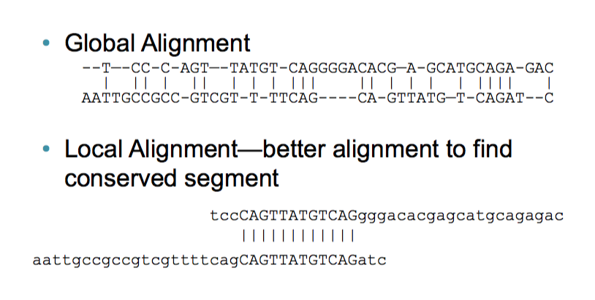
Bioalgorithms.info

Slide 51
Local Alignment using Smith-Waterman(1981)
Just like N-W Except:
Edges are initialized to 0
Maximum score is never less than 0. No pointer unless score recorded
Traceback starts from the highest score in the matrix

Slide 52
N-W matrix
 |  | A | A | G | C | A | T | T | C | C | A
 | 0 | -2 | -4 | -6 | -8 | -10 | -12 | -14 | -16 | -18 | -20
t | -2 | -1 | -3 | -5 | -7 | -9 | -9 | -11 | -13 | -15 | -17
t | -4 | -3 | -2 | -4 | -6 | -8 | -8 | -8 | -10 | -12 | -14
c | -6 | -5 | -4 | -3 | -3 | -5 | -7 | -9 | -7 | -9 | -11
c | -8 | -7 | -6 | -5 | -2 | -4 | -6 | -8 | -8 | -6 | -8
g | -10 | -9 | -8 | -5 | -4 | -3 | -5 | -7 | -9 | -9 | -7
t | -12 | -11 | -10 | -7 | -6 | -5 | -2 | -4 | -6 | -8 | -10
t | -14 | -13 | -12 | -9 | -8 | -7 | -4 | -1 | -3 | -5 | -7
c | -16 | -15 | -14 | -13 | -8 | -9 | -6 | -3 | 0 | -2 | -4
g | -18 | -17 | -16 | -13 | -10 | -9 | -8 | -5 | -2 | -1 | -3
g | -20 | -19 | -18 | -15 | -12 | -11 | -10 | -7 | -4 | -3 | -2

Slide 53
N-W matrix
 |  | A | A | G | C | A | T | T | C | C | A
 | 0 | -2 | -4 | -6 | -8 | -10 | -12 | -14 | -16 | -18 | -20
t | -2 | -1 | -3 | -5 | -7 | -9 | -9 | -11 | -13 | -15 | -17
t | -4 | -3 | -2 | -4 | -6 | -8 | -8 | -8 | -10 | -12 | -14
c | -6 | -5 | -4 | -3 | -3 | -5 | -7 | -9 | -7 | -9 | -11
c | -8 | -7 | -6 | -5 | -2 | -4 | -6 | -8 | -8 | -6 | -8
g | -10 | -9 | -8 | -5 | -4 | -3 | -5 | -7 | -9 | -9 | -7
t | -12 | -11 | -10 | -7 | -6 | -5 | -2 | -4 | -6 | -8 | -10
t | -14 | -13 | -12 | -9 | -8 | -7 | -4 | -1 | -3 | -5 | -7
c | -16 | -15 | -14 | -13 | -8 | -9 | -6 | -3 | 0 | -2 | -4
g | -18 | -17 | -16 | -13 | -10 | -9 | -8 | -5 | -2 | -1 | -3
g | -20 | -19 | -18 | -15 | -12 | -11 | -10 | -7 | -4 | -3 | -2

Slide 54
S-W matrix
 |  | A | A | G | C | A | T | T | C | C | A
 | 0 | 0 | 0 | 0 | 0 | 0 | 0 | 0 | 0 | 0 | 0
t | 0 | 0 | 0 | 0 | 0 | 0 | 1 | 1 | 0 | 0 | 0
t | 0 | 0 | 0 | 0 | 0 | 0 | 1 | 2 | 0 | 0 | 0
c | 0 | 0 | 0 | 0 | 1 | 0 | 0 | 0 | 3 | 1 | 0
c | 0 | 0 | 0 | 0 | 1 | 0 | 0 | 0 | 1 | 4 | 2
g | 0 | 0 | 0 | 1 | 0 | 0 | 0 | 0 | 0 | 0 | 3
t | 0 | 0 | 0 | 0 | 0 | 0 | 1 | 1 | 0 | 0 | 1
t | 0 | 0 | 0 | 0 | 0 | 0 | 1 | 2 | 0 | 0 | 0
c | 0 | 0 | 0 | 0 | 1 | 0 | 0 | 0 | 3 | 1 | 0
g | 0 | 0 | 0 | 1 | 0 | 0 | 0 | 0 | 0 | 2 | 0
g | 0 | 0 | 0 | 1 | 0 | 0 | 0 | 0 | 0 | 0 | 1

Slide 55
S-W matrix
Start traceback at the highest score …
 |  | A | A | G | C | A | T | T | C | C | A
 | 0 | 0 | 0 | 0 | 0 | 0 | 0 | 0 | 0 | 0 | 0
t | 0 | 0 | 0 | 0 | 0 | 0 | 1 | 1 | 0 | 0 | 0
t | 0 | 0 | 0 | 0 | 0 | 0 | 1 | 2 | 0 | 0 | 0
c | 0 | 0 | 0 | 0 | 1 | 0 | 0 | 0 | 3 | 1 | 0
c | 0 | 0 | 0 | 0 | 1 | 0 | 0 | 0 | 1 | 4 | 2
g | 0 | 0 | 0 | 1 | 0 | 0 | 0 | 0 | 0 | 0 | 3
t | 0 | 0 | 0 | 0 | 0 | 0 | 1 | 1 | 0 | 0 | 1
t | 0 | 0 | 0 | 0 | 0 | 0 | 1 | 2 | 0 | 0 | 0
c | 0 | 0 | 0 | 0 | 1 | 0 | 0 | 0 | 3 | 1 | 0
g | 0 | 0 | 0 | 1 | 0 | 0 | 0 | 0 | 0 | 2 | 0
g | 0 | 0 | 0 | 1 | 0 | 0 | 0 | 0 | 0 | 0 | 1

Slide 56
S-W matrix
Alignment = TTCC
TTCC
 |  | A | A | G | C | A | T | T | C | C | A
 | 0 | 0 | 0 | 0 | 0 | 0 | 0 | 0 | 0 | 0 | 0
t | 0 | 0 | 0 | 0 | 0 | 0 | 1 | 1 | 0 | 0 | 0
t | 0 | 0 | 0 | 0 | 0 | 0 | 1 | 2 | 0 | 0 | 0
c | 0 | 0 | 0 | 0 | 1 | 0 | 0 | 0 | 3 | 1 | 0
c | 0 | 0 | 0 | 0 | 1 | 0 | 0 | 0 | 1 | 4 | 2
g | 0 | 0 | 0 | 1 | 0 | 0 | 0 | 0 | 0 | 0 | 3
t | 0 | 0 | 0 | 0 | 0 | 0 | 1 | 1 | 0 | 0 | 1
t | 0 | 0 | 0 | 0 | 0 | 0 | 1 | 2 | 0 | 0 | 0
c | 0 | 0 | 0 | 0 | 1 | 0 | 0 | 0 | 3 | 1 | 0
g | 0 | 0 | 0 | 1 | 0 | 0 | 0 | 0 | 0 | 2 | 0
g | 0 | 0 | 0 | 1 | 0 | 0 | 0 | 0 | 0 | 0 | 1

Slide 57
Exercise
S-W alignment of
Top: ATGCGT
Bottom: GCCCGT
Sub matrix: +1 for match, -1 for mismatch
Gap = -1
Recursion relation:
T(i-1, j-1) + score
T(i-1, j) + gap
T(i, j-1) + gap

Slide 58
Software for making alignments
For N-W and S-W pairwise alignments
pairwiseAlignment() in the “Biostrings” R library
EMBOSS (http://emboss.sourceforge.net/) needle and water programs

Slide 59
Limitations to N-W and S-W
Primarily computational: they work well for short sequences but scale poorly for genome sized alignments
Also the search space (= query length * total length of the letters in the sequences databases) is now too vast

Slide 60
BLAST
Basic Local Alignment Search Tool
Fast
Flexible: many different varieties for nucleotide analysis (BLASTN), proteins (BLASTP), querying nucleotides against protein databases (BLASTX) etc ..
Heuristic algorithm (nt guaranteed to report the correct answer)
Karlin-Altschul Statistical model

Slide 61
How BLAST works
Find word hits – seeds. W = length of seed.
Look for T seeds in neighborhood
Extension of seeds – S-W local alignment
Evaluation/Scoring
Statistics to determine whether match is significant

Slide 62
1. Exact word matches (seeds) located
W=3
Query sequence
AAT
|||
AAT
Database sequence
GAC
|||
GAC

Slide 63
2. Seeds within T bases identified
Query sequence
Database sequence

Slide 64
3. Alignments extended
Query sequence
Database sequence

Slide 65
4. Scores calculated, low-scoring pairs (above E parameter) removed
High-scoring pair
Query sequence
Database sequence

Slide 66
High Scoring Pair
E (Expectation score)

Slide 67
5. E score for match between query and database sequence calculated
E is the expectation score. E score is the number of similar alignments expect by chance
Based on Karlin-Altschul statistics (1990)

Slide 68
Expectation score for an ungapped local alignment
E = k.mne^{-λS}
(k is a constant)

Slide 69
Expectation score for an ungapped local alignment
E = k.mne^{-λS}
m = query length, n = number of letters in database, therefore mn = query search space

Slide 70
Expectation score for an ungapped local alignment
E = k.mne^{-λS}
S = raw score, λ = normalizing constant, therefore λS
= normalized HSP score

Slide 71
Altering BLAST parameters can drastically affect results reported

Slide 72
How BLAST parameters affect performance
Larger values of W decreases chance seeds in - the database -> decrease in specificity, increase in speed
(megablast uses long W scores)

Slide 73
How BLAST parameters affect performance
T = number of seeds needed in a neighborhod to initiate an alignment
Larger values of T decrease execution time but also decrease sensitivity

Slide 74
How BLAST parameters affect performance
Larger E parameter (which means lower S threshold) increases specificity at the cost of sensitivity

Slide 75
Further Reading
Practical on pairwise alignment in R in the Little Book of R for Bioinformatics:
https://a-little-book-of-r-for-bioinformatics.readthedocs.org/en/latest/src/chapter4.html
The Statistics of Sequence Similarity Scores
http://www.ncbi.nlm.nih.gov/BLAST/tutorial/Altschul-1.html
Dewey, C. N. Whole-genome alignment. Methods Mol. Biol. 855, 237–257 (2012).

Slide 76
Extra lecture

Slide 77
Whole Genome Alignment (WGA)
Vital for many downstream genomewide comparisons – e.g. building phylogenies, detecting positive selection and recombination

Slide 78
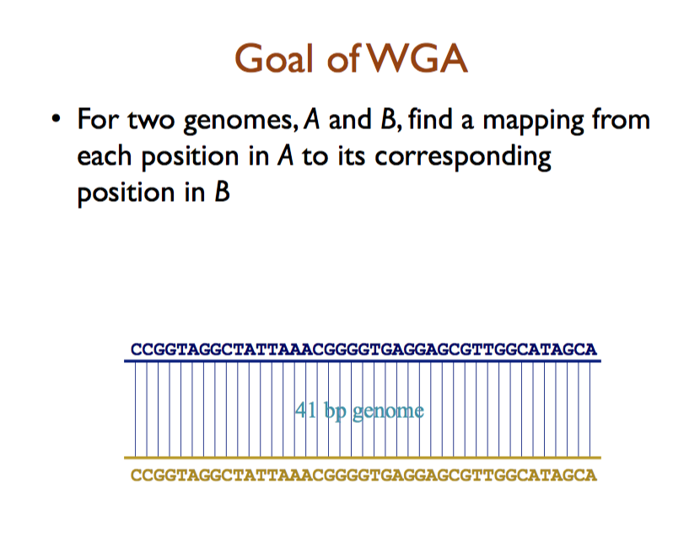
Adam Phillipy

Slide 79
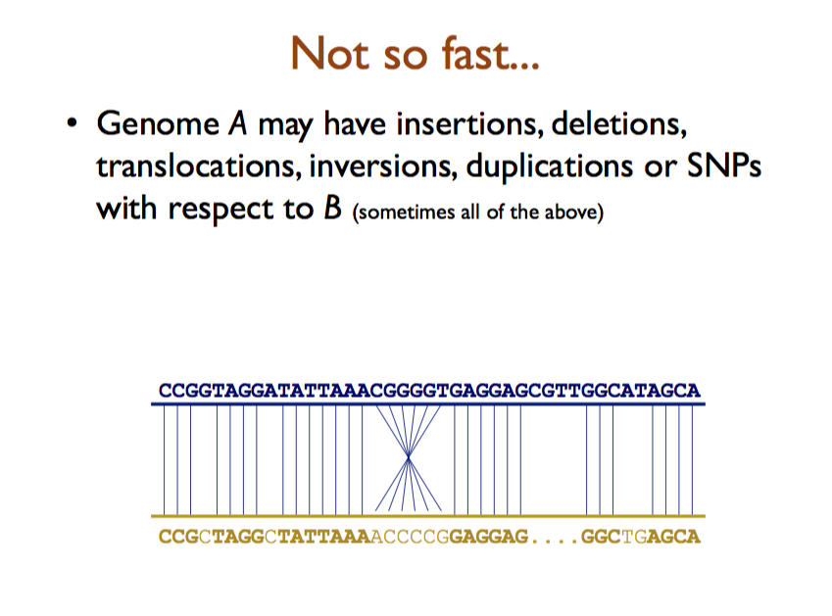
Adam Phillipy

Slide 80
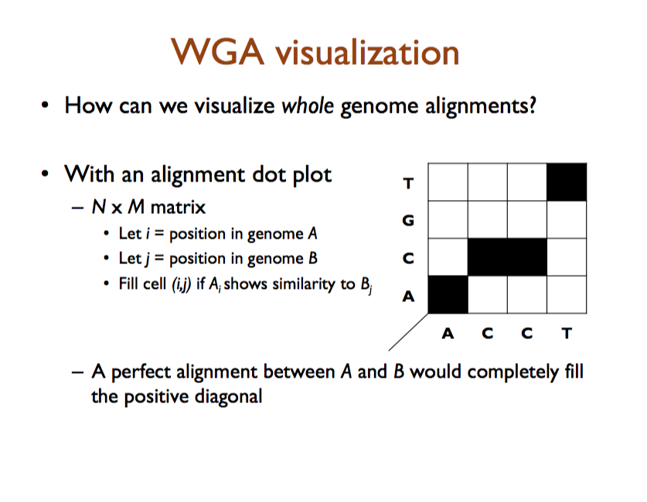
Adam Phillipy

Slide 81
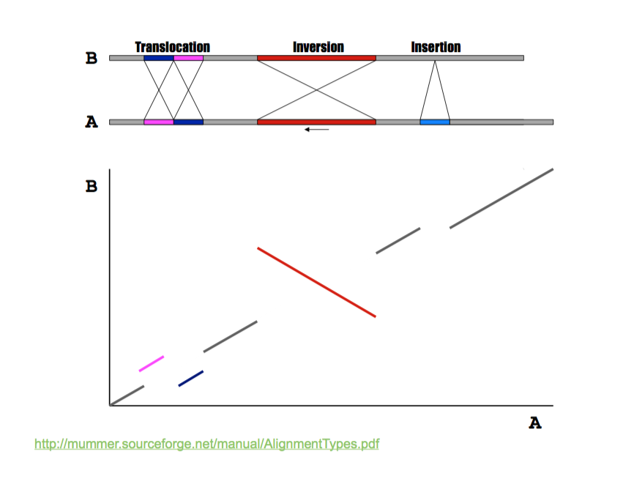
Adam Phillipy

Slide 82
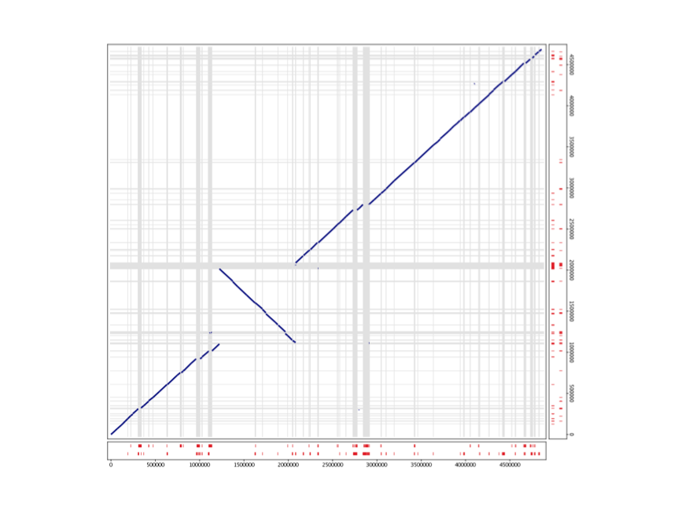
Adam Phillipy

Slide 83
The simplest approach - BLASTN for whole genome alignment
Can use megablast – optimized for rapid alignment of large, very similar sequences
Large word size (W = 16 +) highly specific, low sensitivity
DNA alignment optimized for speed.
Will only produce genome-wide alignment for highly similar, co-linear, sequences
What if you want to compare multiple genomes?

Slide 84
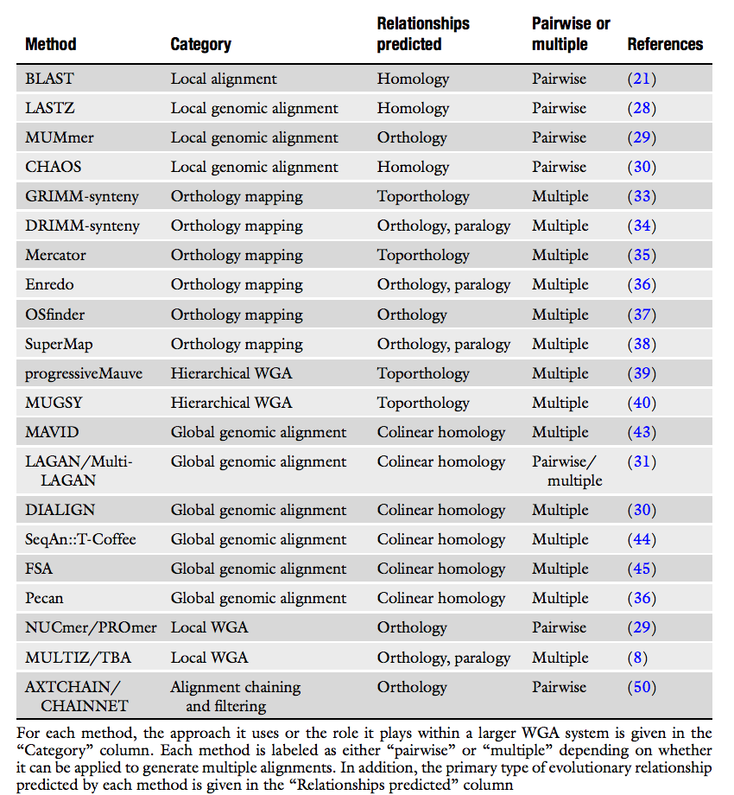
A plethora of WGA Software
Dewey, C. N. Whole-genome alignment. Methods Mol. Biol. 855, 237–257 (2012).

Slide 85
Tradeoffs
Each software is a tradeoff between trying to achieve multiple goals
Execution speed
Multi-genome alignment – how many genomes
Sensitivity – what proportion of the genomes are aligned
Specificity (aka accuracy) – how confident are we that the matches are real

Slide 86
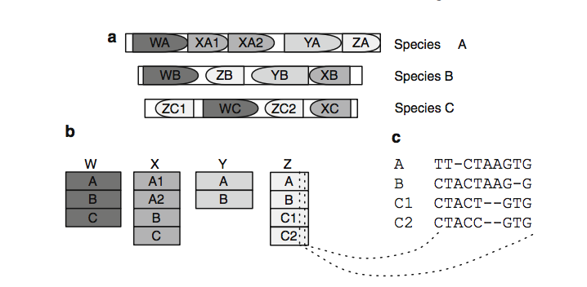
Alignment blocks
Many WGA programs decompose genomes into locally similar blocks
Dewey, C. N. Whole-genome alignment. Methods Mol. Biol. 855, 237–257 (2012).

Slide 87
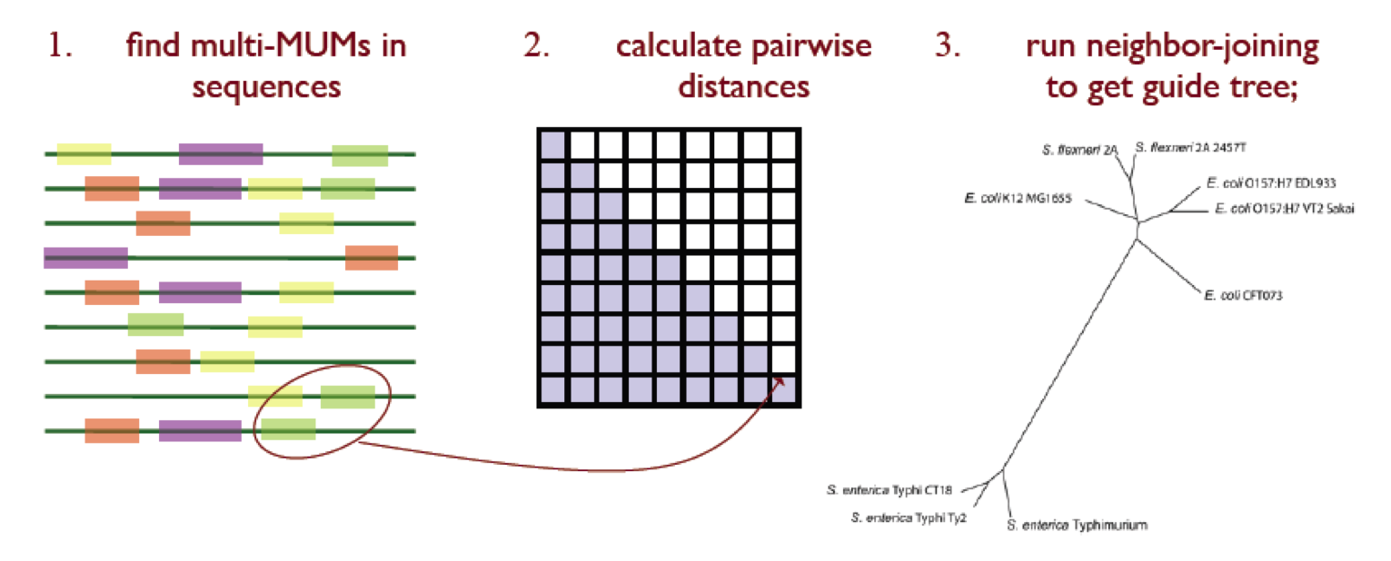
Guidetrees
Hierarchical aligners compare most similar genomes first for increased efficiency
Colin Dewey

Slide 88
An example: progressiveMAUVE
Does not assume that genomes are colinear
Looks for positional homology multiple genome alignments
Calculates pairwise locally colinear blocks – “a set of local alignments that occur in the same order and orientation in a pair of genomes”
Darling, A. E., Mau, B. & Perna, N. T. progressiveMauve: multiple genome alignment with gene gain, loss and rearrangement. PLoS One 5, e11147 (2010).

Slide 89
MAUVE algorithm
Find local alignments (multi-MUMs).
Use the multi-MUMs to calculate a phylogenetic guide tree.
Select a subset of the multi-MUMs to use as anchors—these anchors are partitioned into collinear groups called LCBs.
Perform recursive anchoring to identify additional alignment anchors within and outside each LCB.
Perform a progressive alignment of each LCB using the guidetree.

Slide 90
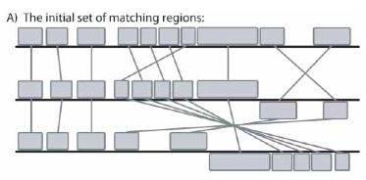
Mauve 1
Darling, A. C. E., Mau, B., Blattner, F. R. & Perna, N. T. Genome Res. 14, 1394–1403 (2004).

Slide 91
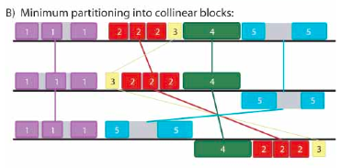
Mauve 2

Slide 92
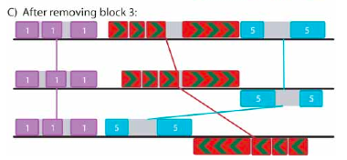
Mauve 3
Recursively remove weakest MUMs and coalesce colinear blocks to remove breakpoints

Slide 93
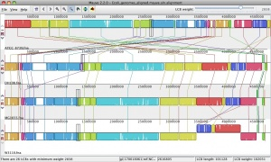
Mauve example: E. coli genomes
ecoliwiki

Slide 94
Another WGA software: MUMmer - Suffix tree-based homology
Designed for fast alignment of large, closely related sequences
Assumption: There is a mapping between large subsequences of the two inputs
Limitations: Only two genomes at the time
A.L. Delcher, et al., 1999, Nucleic Acid Research.

Slide 95
MUMmer
Identify all MUMs
A Maximal Unique Match is a subsequence that occurs exactly (100% identity) once in Genome A and once in Genome B, and is not contained in any longer such sequence
Use the suffix tree data structure for efficiency for both run time and space
Extract the longest set of matches that occur in the same order in both genomes

Slide 96
Suffix tree
A suffix tree is a compact representation that stores all possible suffixes of an input sequence S
A suffix is a subsequence that begins at any position in the sequence and extends to the end of the sequence
G A A C C G A C C T
1 2 3 4 5 6 7 8 9 10
0
A
C
GA
T
1
1
2
10
ACCGACCT
CC
GACCT
C
T
ACCGACCT
CCT
2
3
5
2
9
1
6
GACCT
T
GACCT
T
3
7
4
8

Slide 97
MUMmer Pros/Cons
Pros
Very fast for alignment of genomes of different strains of the same species or genomes of similar species
Can handle long insertions and deletion
Can detect inversion, SNPs, repeat and tandem repeats
Cons
Speed suffer significantly for less similar sequences
Minimum MUM length needs to be set lower

Slide 98
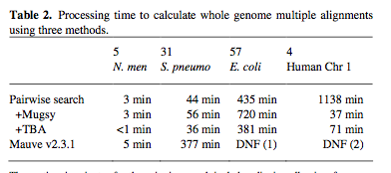
MUGSY
MUMmer optimized for multiple genomes
Anguioli and Salzberg Bioinformatics 2011 vol. 27 (3) pp. 334-42

Slide 99
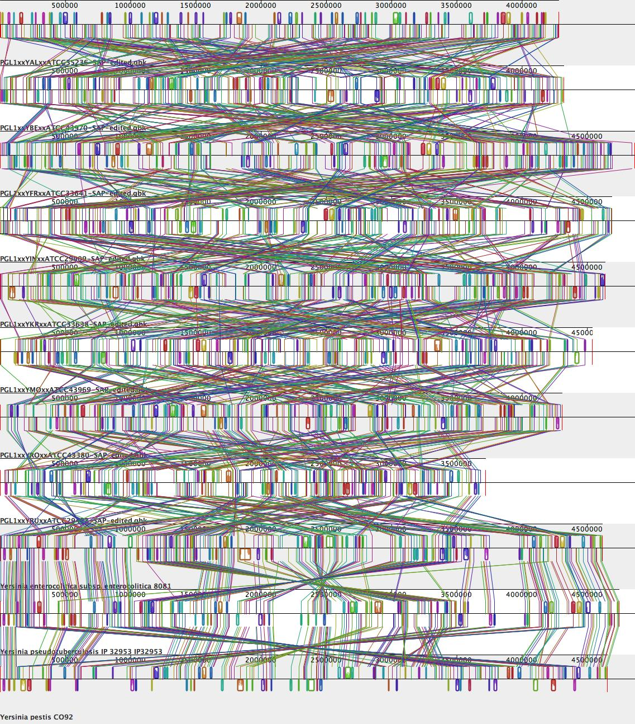
Problems with WGA
Most WGA software has no explicit evolutionary model
Grows exponentially slower with each new genome
Incomplete sequences?
Visualization issues

Slide 100
Evaluation – how to compare WGA tools?
Descriptive Statistics:
Run time
“Coverage” = fraction of the genome aligned
“Core position” = positions with gap free alignments for all members

Slide 101
Summary Concepts
Needleman-Wunsch and Smith-Waterman algorithms provide optimal global and local alignment solutions
BLAST is a heuristic algorithm that allows alignment of sequences to large databases
WGA algorithms are heuristic and are often built on post-processing of smaller local alignment regions

Slide 102
Post WGA analysis
Some ways to view and use the outputs of whole genome alignments

Slide 103
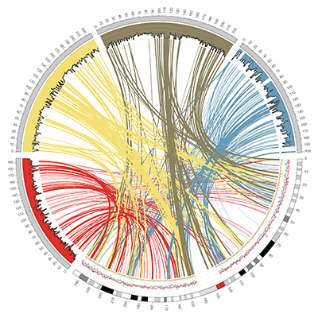
Circos visualization
http://circos.ca/

Slide 104
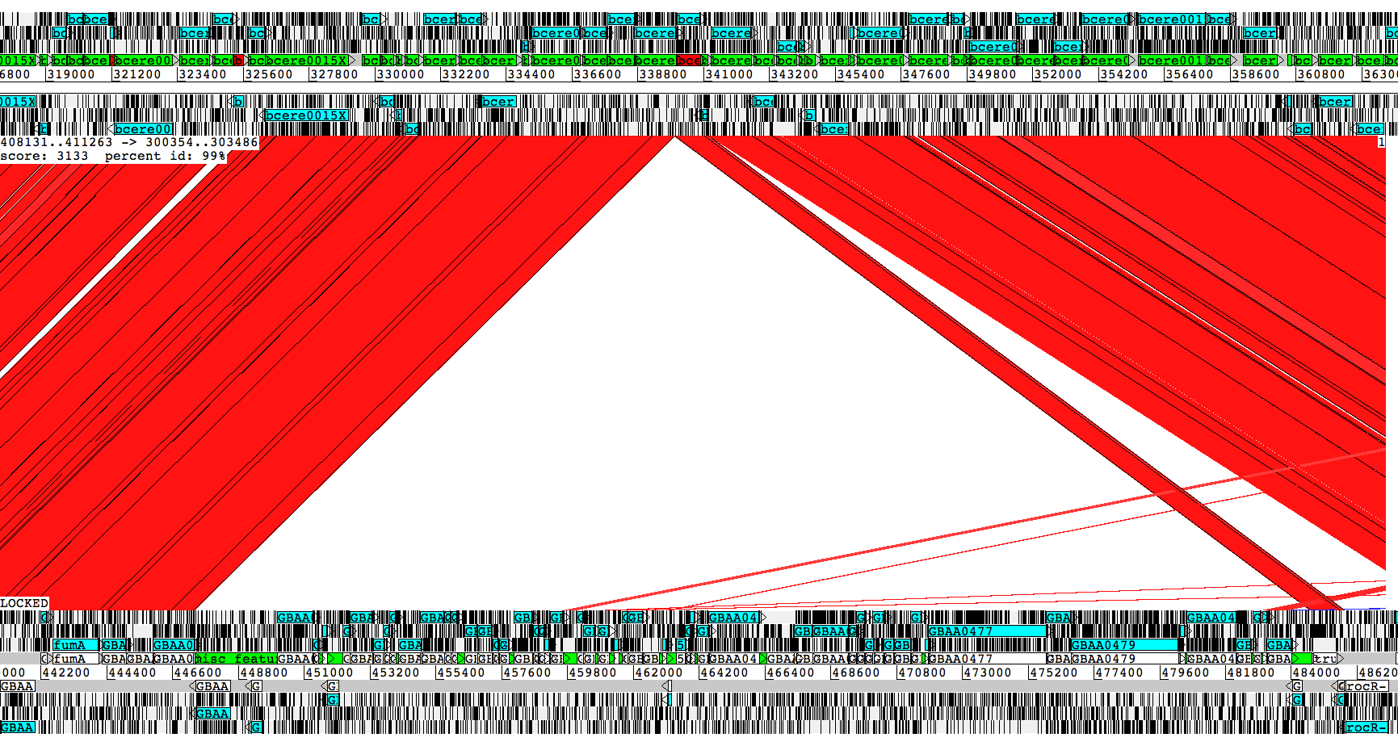
Investigating whole genome alignments using Artemis Comparison Tool
http://www.sanger.ac.uk/resources/software/act/
B. cereus
B. anthracis

Slide 105
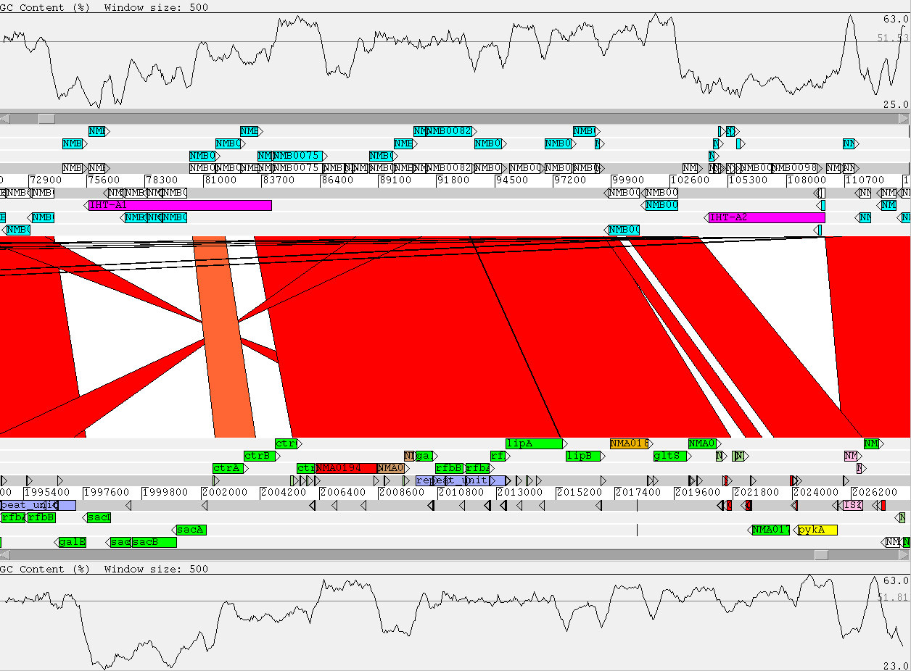
Genome Comparison using Artemis
Neisseria meningitidis MC58 (serogroup B) versus Neisseria meningitidis Z2491 (serogroup A)

Slide 106
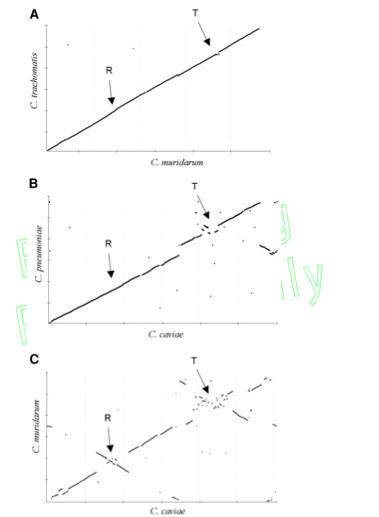
Plotting genome rearrangements over evolutionary time using WGA
16S identity
99%
97%
95%

Slide 107
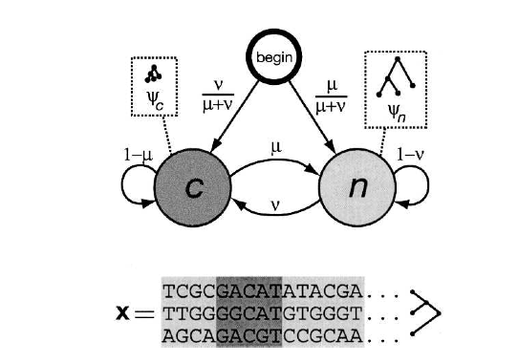
phastCons
Extracts significant significant regions of conservation across the genome based on phylogeny
HMM based model of multi-genome alignment (produced in this case by the MULTIZ aligner program)
Siepel et al Genome Research 2005 vol. 15 (8) pp. 1034-50
Notes:
Human FOXP2 gene and evolutionary conservation is shown in and multiple alignment (at bottom of figure) in this image from the UCSC Genome Browser. Note that conservation tends to cluster around coding regions (exons). (Wikipedia)

Slide 108
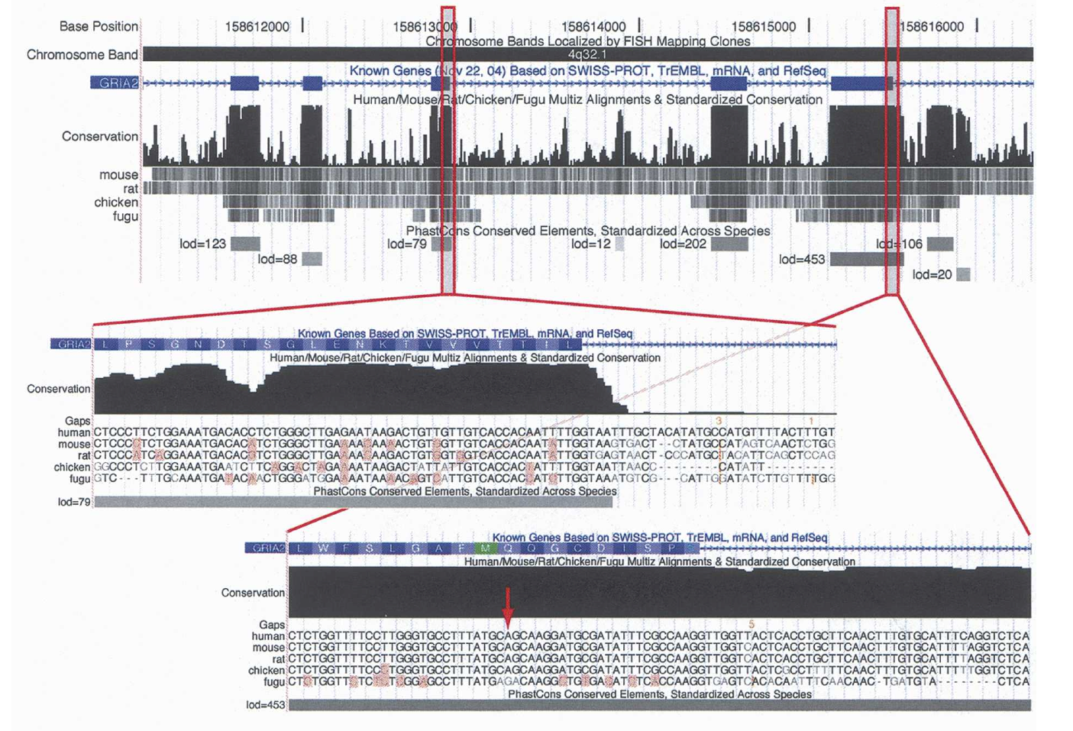
phastCons

Slide 109
Extra extra slides

Slide 110
